Slide 1
Benefits and Compensation
Name
Institutional Affiliation
Date

Slide 2
Introduction
Benefits and compensation are rewards given to employers for work done.
The Labor Laws require that employers compensate their workers commensurately for the job done.
Organizations can also use benefits and compensation as a motivation strategy.
Benefits and compensation occur in different forms.
Notes:
Benefits and compensation are rewards that employers give employees for performing certain tasks. Employers compensate their employees with salaries, medical cover, paid vacations, and allowances, among others. In the US, the federal government has set a minimum wage for all employers Thus, employers are mandated to pay at least the minimum wage or they get fined. Besides, organizations use benefits and compensations as tools to attract the best talents.

Slide 3
Employee Benefits
The contract negotiation by individual employees.
The role of labor unions in negotiating employee benefits and compensations.
Wage control
Government impetus
Employer impetus
Notes:
The first step in establishing employee benefits is the contract negotiation. The employees have an opportunity to negotiate with their employers their salaries, allowances, and other benefits during interviews. The interviewee must ensure they get as much as possible from their employer. Contract negotiation skills are vital during interviews as they impact the amount one gets from their employer. Besides individual negotiation, labor unions also play an instrumental in benefits and compensations. The unions negotiate on behalf of their members for salary increase and other benefits. Unions have numbers which gives them more negotiation power. They provide better prospects during negotiations.

Slide 4
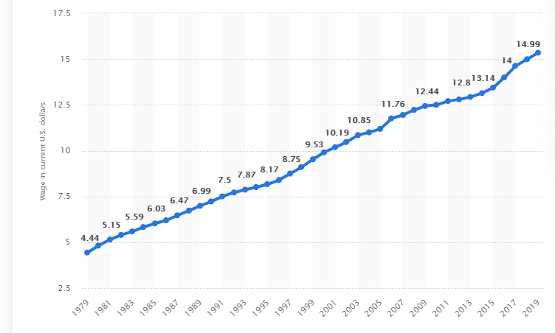
Employee Benefits (Cont..)
The trend indicates that minimum wage has been going up since 1979.
Economic factors such as inflation causes increase in minimum wage.
Government and employer impetus also results in the increase.
Minimum wage trend 1979-2019
Source: Statista
Notes:
The chat indicates that the minimum wage has been going up since 1979. It has increased from 4.44 dollars in 1979 to 14.99 dollars in 2019. The gradual but steady increase was a result of economic and political factors in the country. For example, the inflation rates was one of the primary drivers of the increase. Employers and government adjusted their minimum wages to reflect the inflation rates. Similarly, individual employees and labor unions also pushed for increase in wages to sustain their living standards. Currently, there is an ongoing debate on whether to increase the federal minimum wage to reflect the current economic situation.
Besides inflation, increasing competition for talents in the market also leads to higher wages. Organizations provides benefits as incentives to attract top talents. The tech sector is know for offering high wages to workers to attract top talents in the market. Employees with unique talents and skills are on demand resulting in higher wages as incentives.

Slide 5
Legally Required Benefits
Workers’ compensation i.e. salaries and allowances
Unemployment Insurance
Social Security
Family and Medical Leave Act
Notes:
The labor laws provide some mandatory benefits that an employer must give their employees. Firstly, every employer have legal obligation to pay salaries and allowances to their workers. The salary must align with the regulations on various compensation standards. Employers must ensure that their workers get their pay on time and in full amount based in the agreement. Employees can sue their workers for failing to pay their salaries on time.
Additionally, employers have mandate to pay unemployment insurance for their employees. The funds are used in cushioning workers in times of job losses. Unemployment insurance proved vital during the COVID-19 pandemic when the country recorded the highest unemployment level in recent history (Genog, 2020). The federal government used the money to pay unemployment benefits to workers out of work.

Slide 6
Legally Required Benefits (Cont..)
Family and Medical Leave
Social Security
Health Insurance
Employment Retirement Income Security Act
Defined Benefit Plans
Notes:
Family and medical leave is a mandatory benefit provided to employees by the federal labor laws. Every employer in the US must give their employees family and medical leave when necessary. Maternity leave falls under the family and medial leave. Unfortunately, the labor laws in the US does not provide mandatory paid maternity leave. The employers have the discretion to give their workers either paid or unpaid maternity with no legal consequences. The practice contradicts standards in most developed and developing nations where employees have mandatory paid maternity and paternity leaves. The country needs to review it laws on the issue to align the standard practice globally.
Further, Employment Retirement Income Security Act of 1974 was enacted to protect employees after exiting active employment. The Act sets minimum standards for voluntary contributions to pension schemes. It requires the employer to provide the employee with adequate information on the plan and benefits. ERISA demands that employers provide employee with information on fiduciary responsibility, benefit accrual, feature of the scheme, and guarantee payments, among others. In other words, ERISA demands that employers provide their workers with comprehensive information on a subject before enrolling on the scheme.

Slide 7

Social Security
Notes:
Social Security Act was enacted in 1935 to protect retired workers, victims of workplace injuries, people with physical disability, and depend mothers or children. The Act mandates the US government to collect Social Security Tax from employees to provide social services to the target groups. The Act was part of the government’s attempt to protect its vulnerable population from adverse economic and health outcomes. Social Security Act enabled the government to enforce a payroll tax that goes to supporting social programs. All the employees in the country are mandated to contribute to social security.

Slide 8
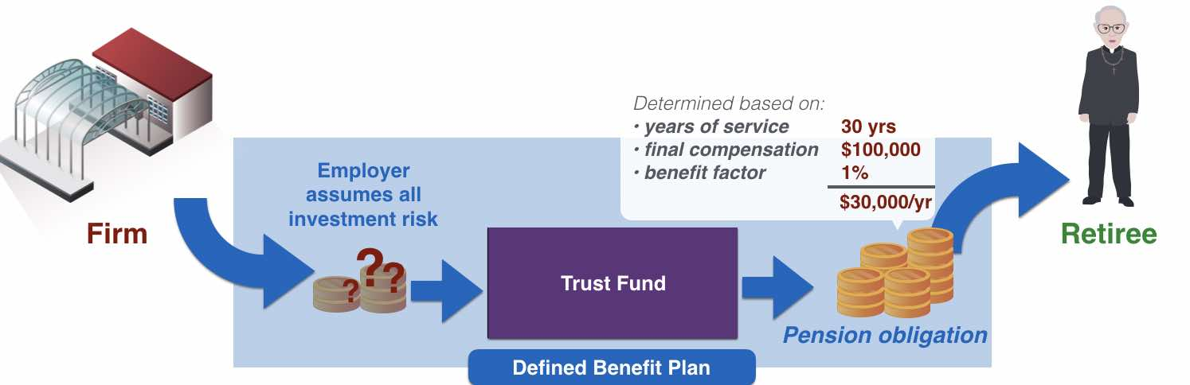
Defined Benefit Plan
The employer provides retirement plan as part of employee benefit.
The amount received by employee depends on the duration of services.
Aims at ensuring long-term commitment.
Notes:
Defined benefit plan is also a scheme that employers use to offer incentives to their workers. The scheme involves providing employees with guaranteed monthly income at the end of their services to the company. Defined benefit plan act as the firm’s commitment to their workers social well-being even after exiting the organization. The assurance of social safety motivates workers to focus on their jobs as they have secured future (Okun, 2021). Defined benefit scheme is sponsored by employers for their workers.

Slide 9
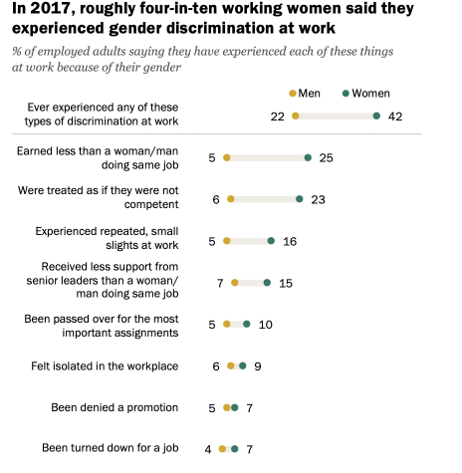
US Federal Pay Regulations
Source: Pew Research
Notes:
The federal labor laws require that organizations avoid pay discrimination of any form. The country has enacted several laws that outlaws pay discrimination for employees. For instance, the Equal Pay Act demands that employers pay workers the same amount for equal work done. Similarly, the Civil Rights Act outlaws pay discrimination of any form. The Civil Rights Act paved way for enactment for various legislation that outlaws discrimination at the workplace, including access to opportunities for professional growth. However, women are and other minority groups are still disadvantaged. Women are still underpaid in most jobs despite the existing laws prohibiting similar practices.

Slide 10
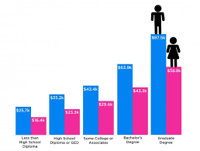
The Equal Pay Act
Courtesy: Jesuit Social Research Institute
Notes:
The Equal Pay Act of 1963 is an amendment of the Fair Labor Standards Act of 1938 that aimed at eliminating sex-based pay discrimination. The Act aimed at forcing employers to provide equal compensation for all employers for equal work done, regardless of their sex. The Equal Employment Opportunity Commission enforces the law. Any individual who feel they are discriminated based on their sex. EEOC is mandated to implement the Equal Pay Act and promote fair labor practices in the country.

Slide 11
Reverse Discrimination
Reverse Discrimination describes the discrimination f dominant groups.
It is Illegal in federal workplaces
The Supreme Court outlawed Racial quotas.
Organizations must protect the interests of every group
Notes:
Reverse discrimination is the discrimination of the dominant group in a society. The focus on affirmative action and push for equality and diversity at the workplaces resulted negative unintended consequences. For example, the dominant groups (white males in US) found themselves locked out of opportunities as organizations strived to increase their racial and gender diversity. However, reverse discrimination is illegal in the US and companies can face penalties if found guilty.

Slide 12
Conclusion
Employment benefits are critical in recruiting and retaining workforce
The federal labor laws provide legal framework for employee compensations.
Employers have legal obligations to pay their workers on time to avoid legal repercussions.
The country outlaws any form of pay discrimination.
The Equal Pay Act demands that employers provide fair and equal remuneration for work done, regardless of gender.

Slide 13
References
Ganong, P., Noel, P., & Vavra, J. (2020). US unemployment insurance replacement rates during the pandemic. Journal of public economics, 191, 104273.
Graf, N., Brown, A., & Patten, E. (2018). The narrowing, but persistent, gender gap in pay. Pew Research Center, 9.
Okum, L. R. (2021). Defined Benefit Plan Funding During the Pandemic. Journal of Pension Benefits, 16-20.

